Slide 1
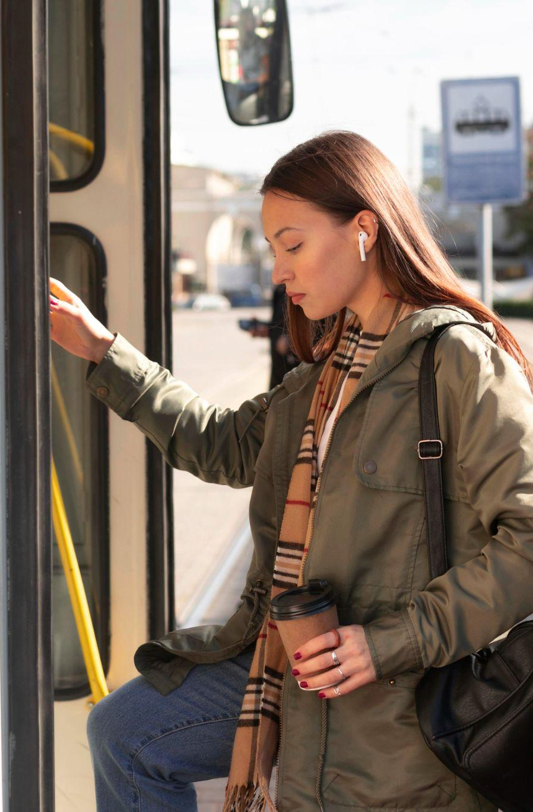
On Time, All Aboard: Analyzing WeGo Public Transit Adherence and Performance
Good Wheel Hunting

Slide 2
01
02
Table of contents
03
04
05
06
Overall On-Time Performance and Adherence Metrics
Impact of Route, Direction, and Location on Punctuality
How Time of Day and Day of Week Shape Adherence
Quantifying the Influence of the Operator on Timeliness
The Correlation Between Lateness and Headway
Conclusion

Slide 3
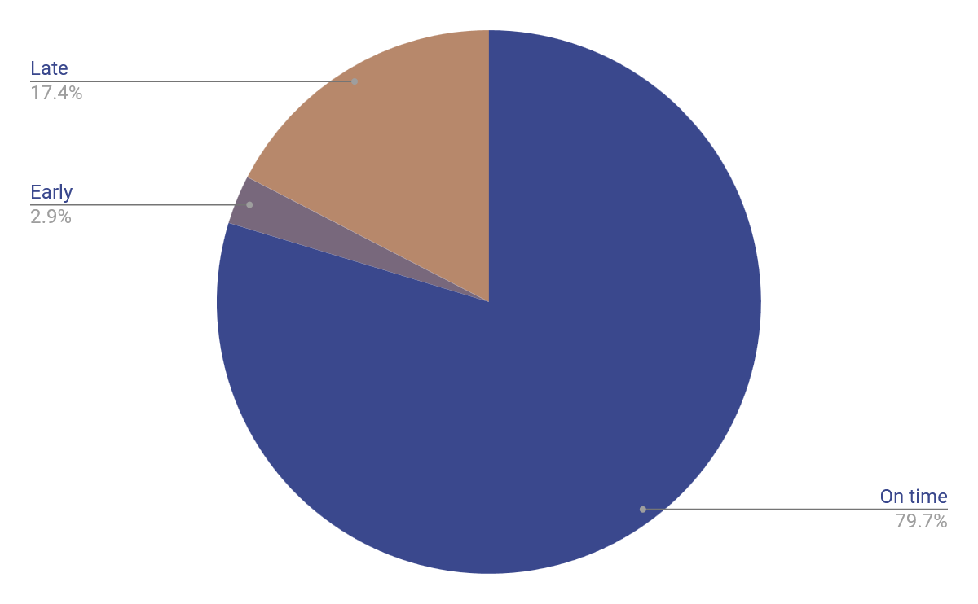
The Rhythms of Transit
On time
Early
Late
Overall Bus Stop Timeliness

Slide 4

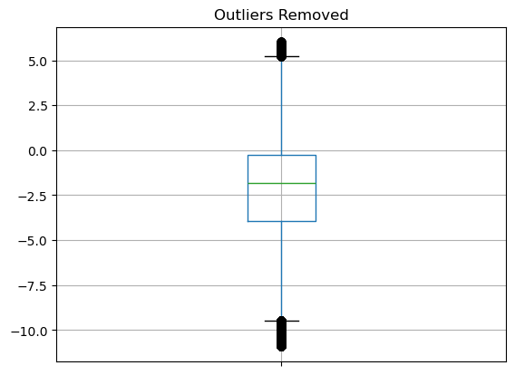
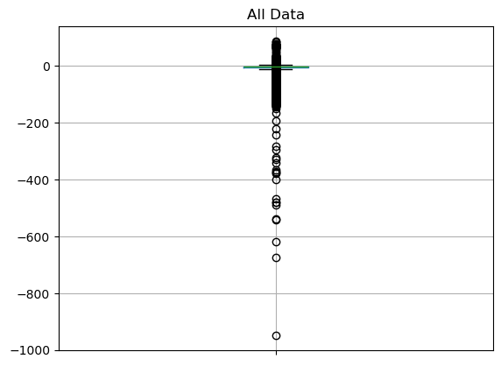
The Rhythms of Transit
Distribution of Adherence

Slide 5
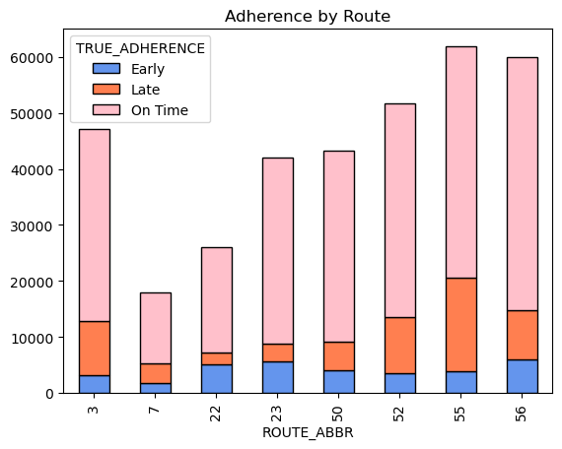
Delays By Route
Notes:
Depending on your route, you can expect most days to be normal unless you are on the west end, Nolensville pike, or Murfreesboro pike. Some lateness can be expected and we apologize for these instances.

Slide 6
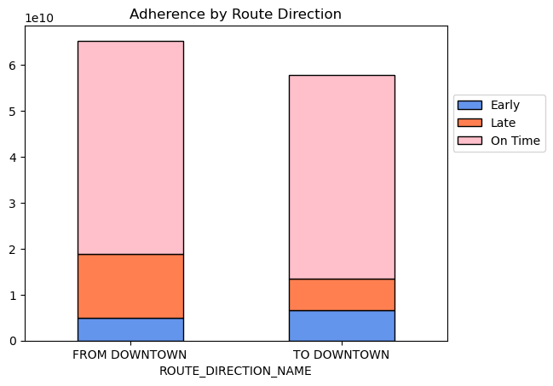
Delays by to and fro
Notes:
As for expected delays, more delays are expected for buses coming from downtown. This is more than likely due to traffic problems but can be covered more intently with following information that our group is providing.

Slide 7
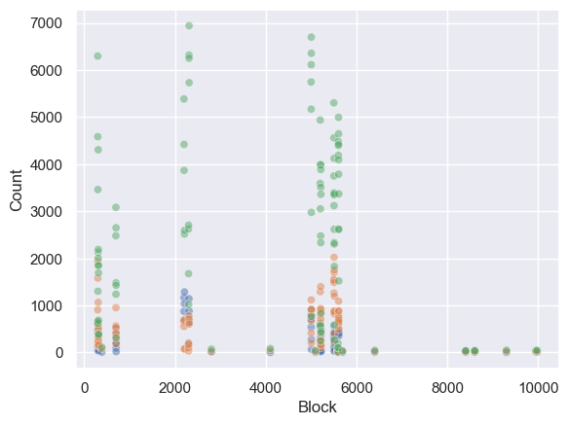
Does my block matter?
Notes:
As for blocks, Green is good, blue means they were early and orange is late. Each block gets a code with the first digits being the route. With this data, you can see that a majority of each route is still meeting our expectations but we can more clearly see the problem areas are Charlotte Pike and Nolensville Pike

Slide 8
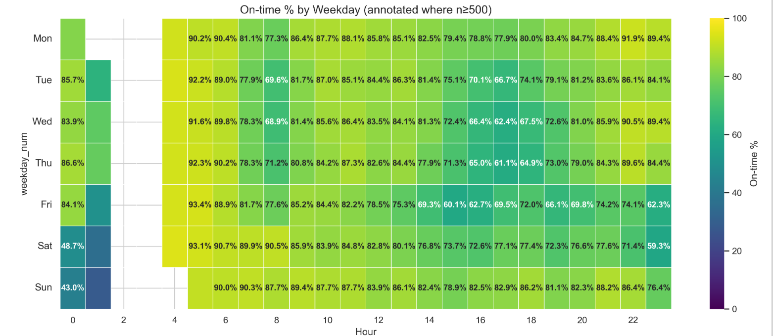
WeGo Public Transit On Time % Hourly

Slide 9
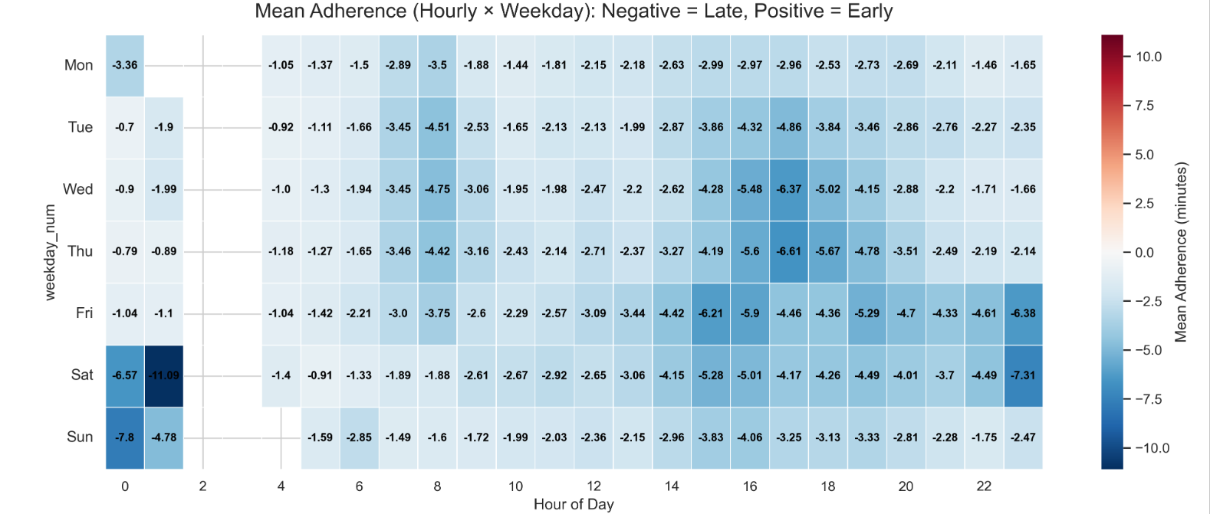
Mean Adherence (Hourly X Weekday)

Slide 10
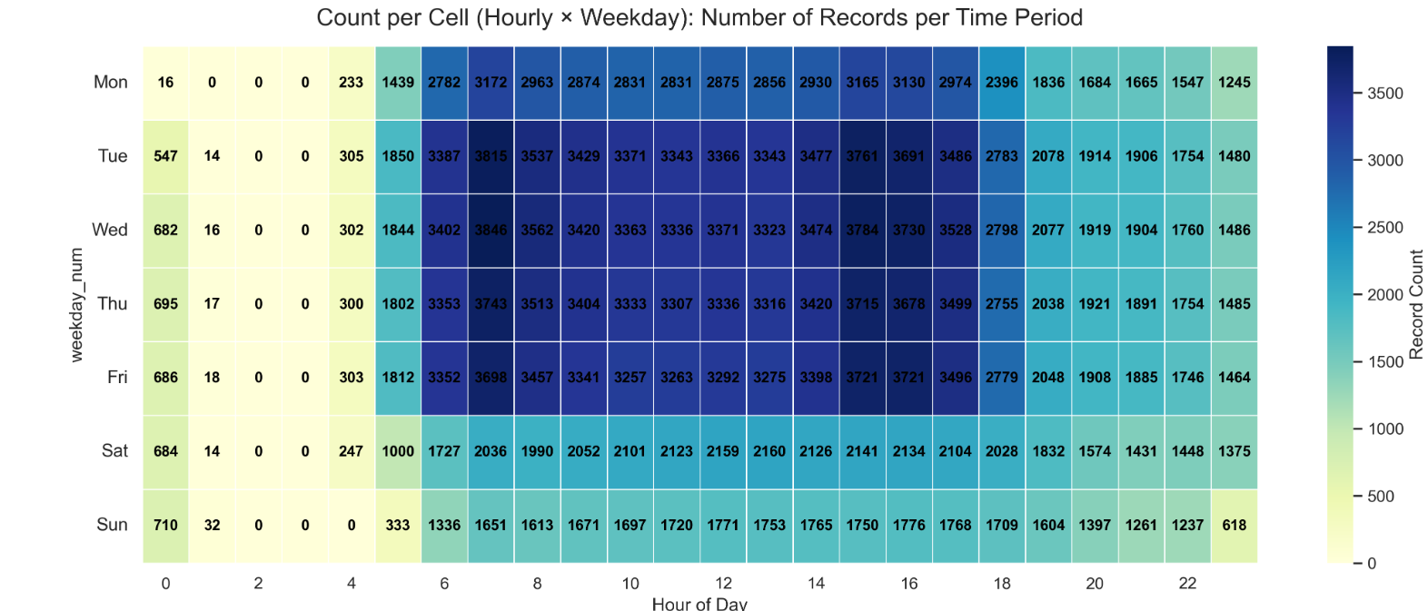
Number of Records Per Time Period

Slide 11
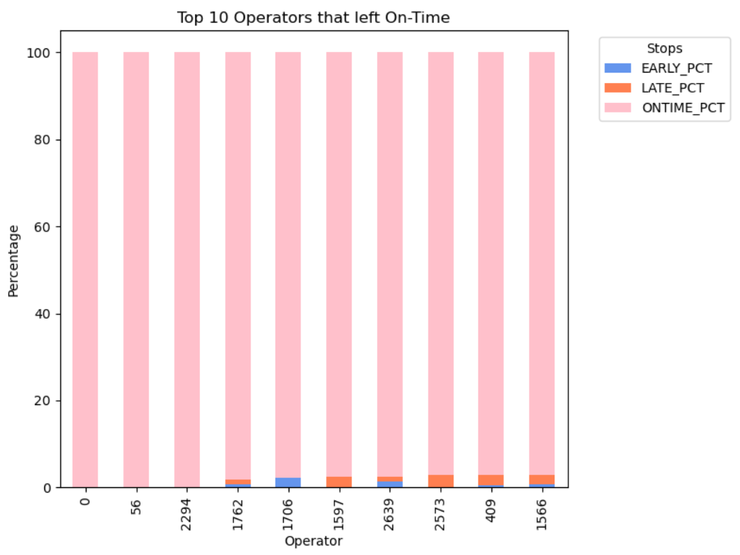
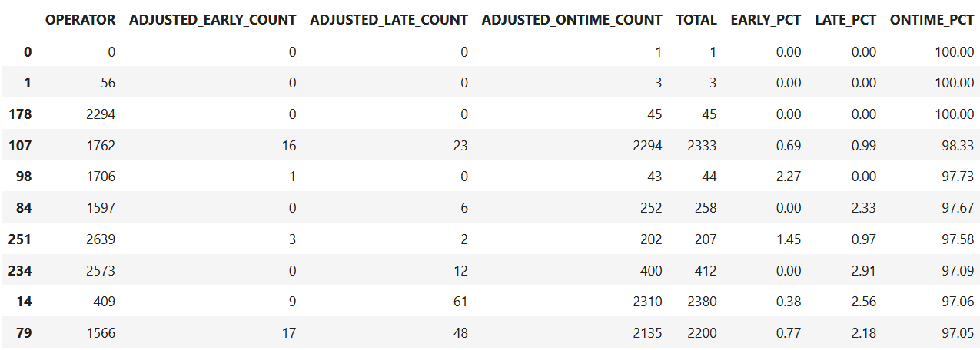
Influence of the Operator on Timeliness
Early
Late
On Time

Slide 12
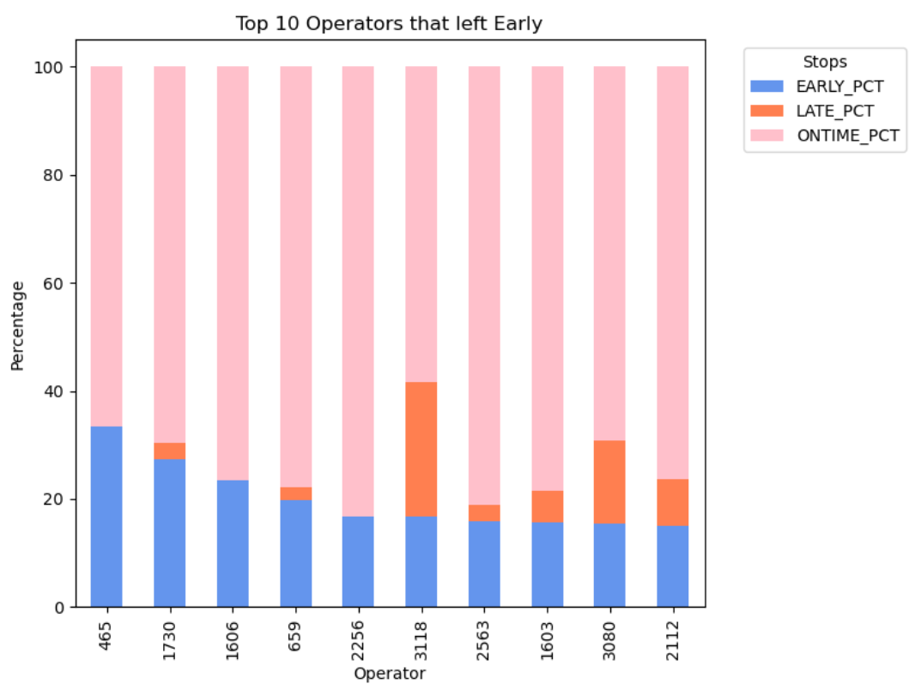
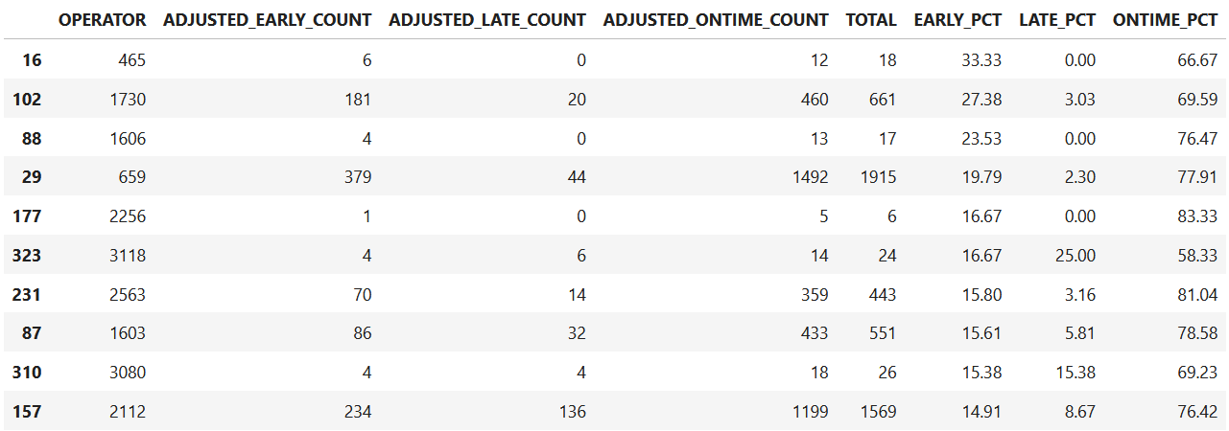
Influence of the Operator on Timeliness
Early
Late
On Time

Slide 13
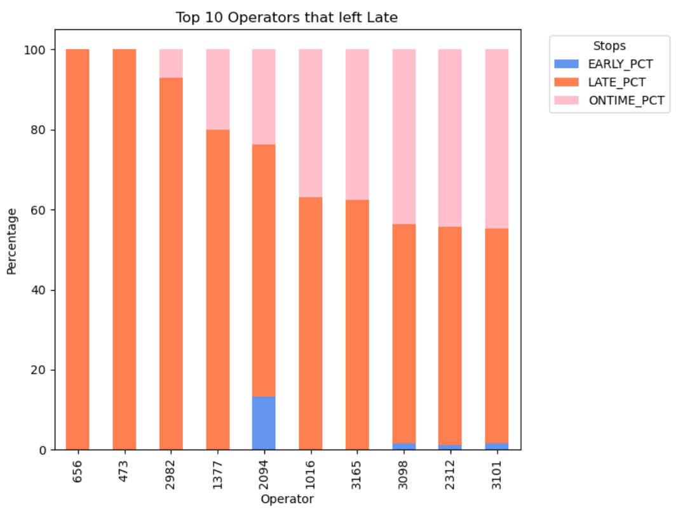
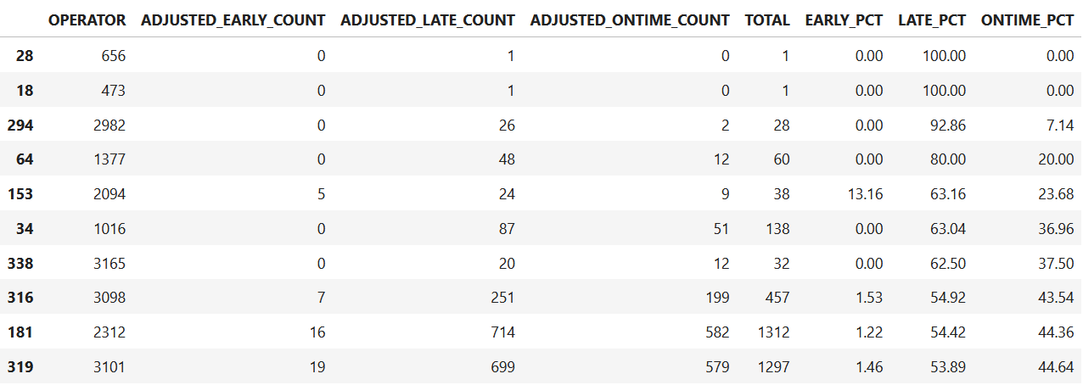
Influence of the Operator on Timeliness
Early
Late
On Time

Slide 14
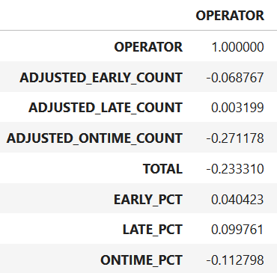
Influence of the Operator on Timeliness
Some Operators frequently leave early or they leave late.
However, the correlation values of 0.04, 0.09, and -0.11 indicate that there is little or no correlation between the Operator and timeliness.

Slide 15

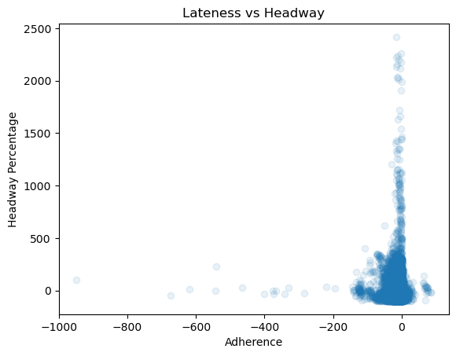
Keeping the Distance
The Relationship Between Adherence and Headway

Slide 16
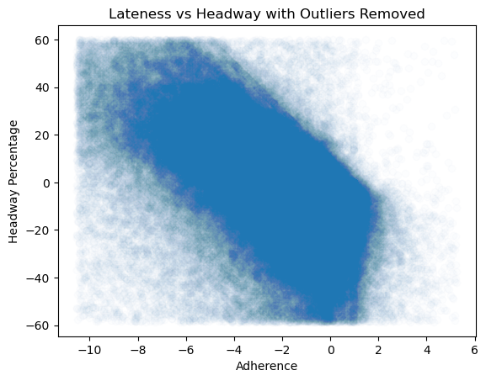
Keeping the Distance
Outliers Aside
The Relationship Between Adherence and Headway
By excluding statistical outliers, the negative correlation becomes more obvious and shows a clear relationship wherein lower adherence often correlates with higher headway percentages and deviations while more moderate adherence ranges correlate with lower headway percentages.

Slide 17
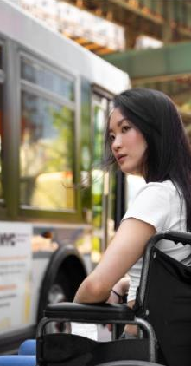
In Summary
Nearly 80% of WeGo buses ran on time, and most of the rest are only slightly off schedule.
Focus on fixing the problems present in west end, Nolensville pike, and Murfreesboro pike along with routes coming from downtown.
WeGo service is most consistent during weekday mid-day hours, with high on-time rates and reliable data.
Some Operators frequently leave a stop early or late, however there is little to no correlation between the Operator and timeliness.
When delays do occur, they impact the entire system.

